Slide 1
Symptoms and Conditions Dataset
Panace.ai

Slide 2
TEAM NO: 5 MENTOR: Dr Kolla Mooraraji
P. JYOTHI SREE - 160120733006
G. MEGHANA - 160120733009
T. NIKHITHA - 160120733012
B. SATVIKA - 160120733014
I.LIKITH REDDY - 160120733033
R. UDAY - 160120733057

Slide 3
About the project
Disease Symptom Dataset
The detection of disease based on disease is a complex game. Being unfamiliar with biological terms, the users feed the symptoms in non-technical or natural terms which add complexity in predicting diseases. The main objective is to develop a novel architecture that could accept and handle such type of user queries by employing techniques like query expansion using a thesaurus, synonym matching, and symptom suggestion that will allow disease prediction with greater accuracy based on user input. We have scraped data from the web and generated dataset which can be used in future research. Query search retrieval and matching are used in such problems to achieve prediction.

Slide 4
Dataset
The dataset consists of diseases and their symptoms, which are fetched from the following sources:
Diseases:
The list of diseases has been retrieved from the National Health Portal of India, developed and maintained by Centre for Health Informatics (CHI). The script fetches the HTML code of the page and extracts the disease list by filtering values in HTML tags.
Symptoms:
The script uses the Google Search package to perform searching and fetch the disease’s Wikipedia page among the various search results obtained. The HTML code of the page is processed to fetch the symptoms of the disease using the ’infobox’ available on the Wikipedia page.

Slide 5
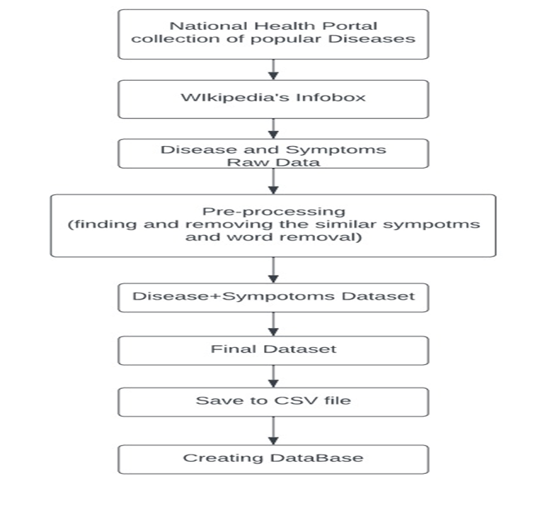

Slide 6
Disease Prediction
1)Take input symptoms from the user.
2)Add the symptoms to the list.
3)Convert the list to the dictionary by adding the key “1” to each symptom.
4)Compare the above dictionary to the dictionaries in the database.
5)If the dictionary be a match with the dictionary in the database then the disease will be predicted.
6)If the wants to know more detail about any disease, they can do so by simply click on the about disease button

Slide 7
Modules used
CSV
pickle
re
numpy
pandas
BeautifulSoup

Slide 8
Technologies used
Flask
Html
MongoDB
pymongo

Slide 9
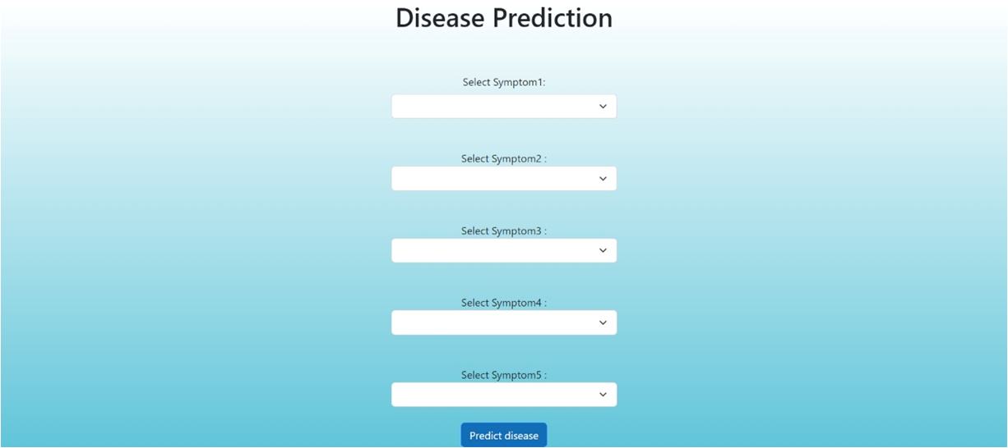
Output

Slide 10
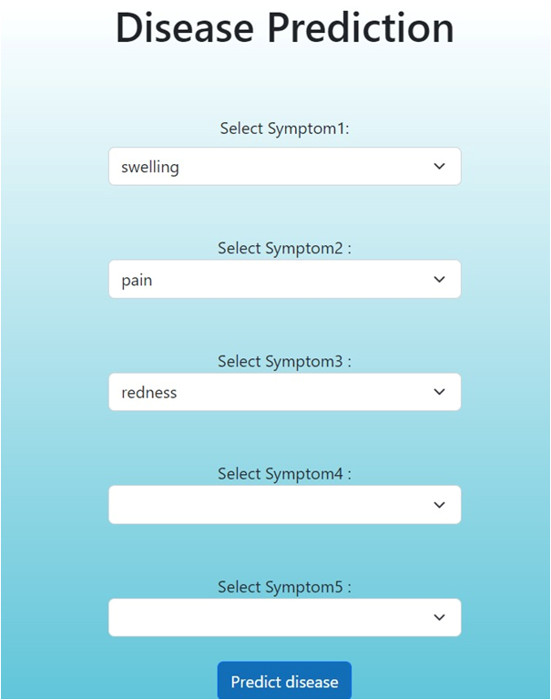

Slide 11


Slide 12
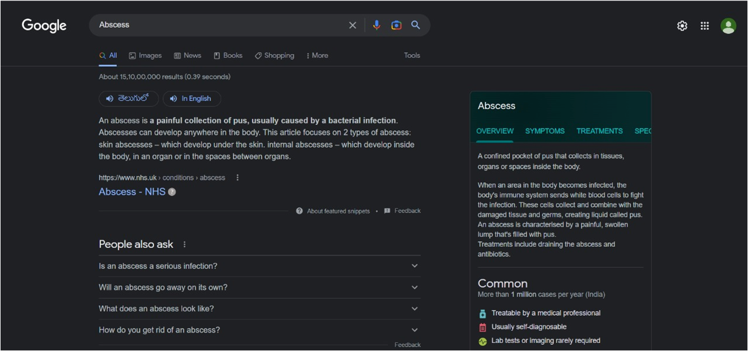

Slide 13
FUTURE SCOPE
We can store the outputs in a database acc to region and we can find frequency of most disease.
We can create the separate database for each user.
We can tell the probability for each disease in case of multiple disease outputs for same symptoms.
We can add the doctor recommendation and hospitals for each user.
We can add chat bot to book appointments.

Slide 14
Thank you

